Slide 1
Introduction to Python
Class 4

Slide 2
Resources
eBook
Hard Copy book
Visualizing Code tool
Cheat Sheets
*Control click to go to the link.

Slide 3
Review: Comparison Operators
Operator | Name | Syntax
> | Greater Than | age > 40
< | Less Than | age< 40
>= | Greater or Equal to | age>= 40
<= | Less than or Equal to | age < =40
== | Equality | age == 40
!= | Not equal to | Age != 40

Slide 4
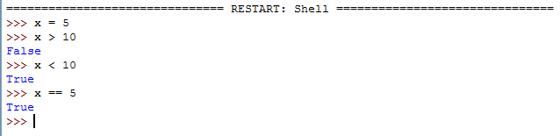
Review: Comparison Operators
Comparison operators return Boolean values abbreviated bool() in Python
Booleans are binary and return only True or False (case sensitive)
In Python, all numbers are True except 0
In Python, all strings are True except a blank string
For loops and conditional statements, Python will only run when True

Slide 5
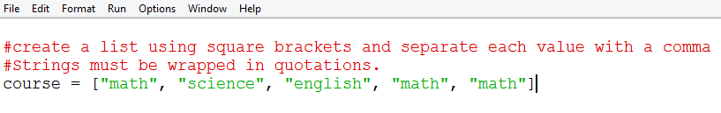
Review: Lists
While variables can store one value at a time, lists can store many values
When naming lists, follow the same naming conventions as naming variables except it is best practice to name lists in the plural (cars, groceries, students)
Lists are mutable meaning they can be changed after they are created
Values in a list can repeat

Slide 6
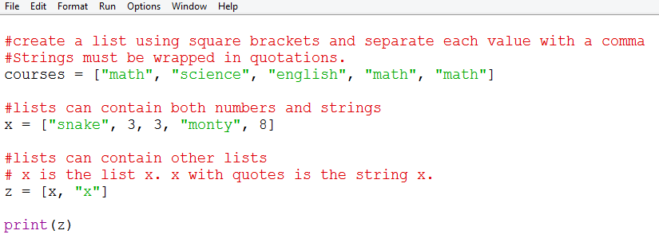
What does this code output?

Slide 7
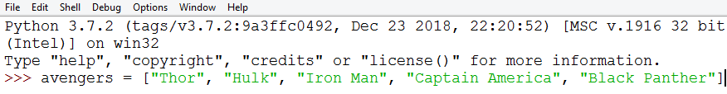
Review: Lists are Indexed
Lists are indexed meaning each value in the list corresponds to an index integer
Lists (as well as ranges) start counting from 0
The first value in the list is index 0, the second item is index 1
Indexing can help you print parts of the list or save them as variables or other lists
Index 0 1 2 3 4

Slide 8
Review Questions
What does each line of code print:
print(avengers[1])
print(len(avengers))
print(avengers[5])
print("Thor" in avengers)
Notes:
The first index which is Hulk. Remember indexing starts at 0
The length of the list is 5.
The fifth index which does not exist. Will return an index error.
Will print the Boolean value True

Slide 9
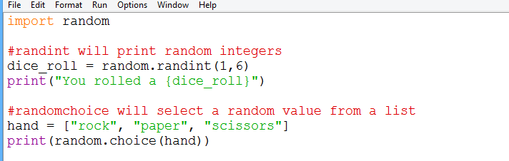
Review: Random library
The random library is pre-built

Slide 10
Review Questions:
What is the difference between x = 5, x==5, and x+=5?
What is the difference between the list methods - pop and del?
How do you import a library?

Slide 11
For Loops vs While loops
Loops allow you to repeat your code and automate tasks
For loops are commonly used to iterate over lists or ranges and you know the code needs to run a certain number of times
A while loop is conditionally based and commonly used when you don’t know how many times the code needs to repeat

Slide 12
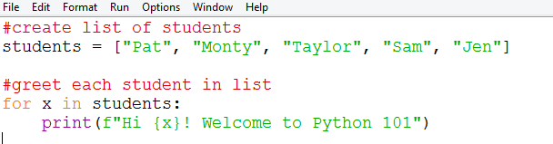
For Loops
The code in the body of the loop is executed repeatedly.
This is called an iteration
Notes:
#create list of students
students = ["Pat", "Monty", "Taylor", "Sam", "Jen"]
#greet each student in list
for x in students:
print(f"Hi {x}! Welcome to Python 101")

Slide 13
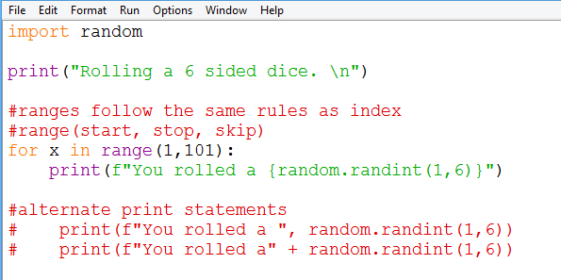
For Loops Example
This program will roll a 6 sided side dice 100 times
Notes:
import random
print("Welcome to the DMV. \n")
#ranges follow the same rules as index
#range(start, stop, skip)
for x in range(1,101):
print(f"Customer number {x} go to booth ",random.randint(1,8))

Slide 14
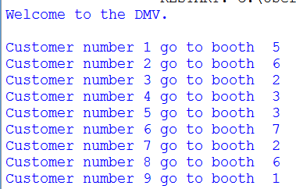
Exercise #1
The DMV has 100 customers and they need to assign each customer to a random booth
Requirements:
print a Welcome message.
Use a for loop to print a line for each customer (there are 100 customers)
Each customer has to be randomly assigned to one of 8 booths in the DMV
Notes:
import random
print("Welcome to the DMV. \n")
#ranges follow the same rules as index
#range(start, stop, skip)
for x in range(1,101):
print(f"Customer number {x} go to booth ",random.randint(1,8))

Slide 15
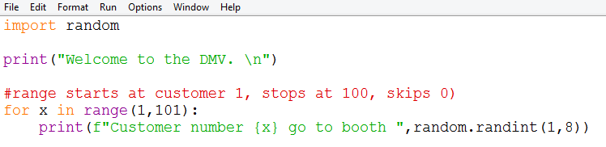
Solution #1

Slide 16
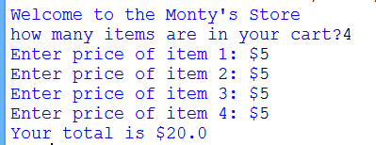
Exercise #2
Monty’s Grocery store would like to implement a self check out system.
Requirements:
Ask the user to input the number of items in their cart
Use a for loop to ask the user for the price of each item in their cart
Once all items have been scanned, print the total

Slide 17
Exercise #2
Montys Dollar Store would like to greet the customer and provide a list of all the items and the prices
Requirements:
Ask the user to input their name. Print a greeting with their name
Create a list of at least 5 items
Use a for-loop to print each item and the price

Slide 18
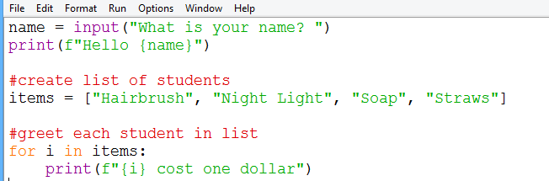
Solution #2
Notes:
name = input("What is your name? ")
print(f"Hello {name}")
#create list of students
items = ["Hairbrush", "Night Light", "Soap", "Straws"]
#greet each student in list
for i in items:
print(f"{i} cost one dollar")

Slide 19
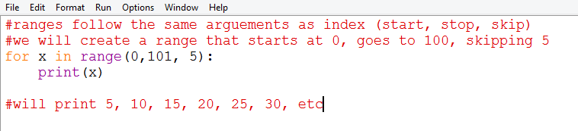
Loops to Iterate over Ranges
Rather than iterating over lists, you can iterate over a range to control exactly how many times the loop runs
Ranges follow the same rules as indexing (inclusive start, exclusive stop, skip)

Slide 20
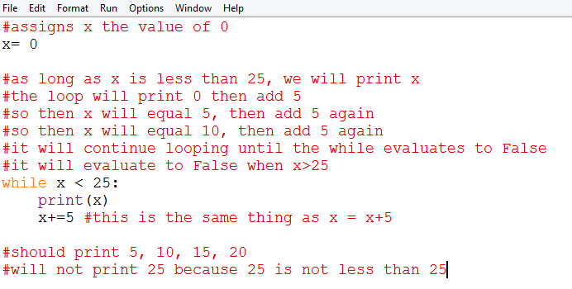
While Loops
While loops follow similar syntax to for loops and if statements (colon after the statement and indentation)
It allows you to loop through certain code as long as the conditions return True

Slide 21
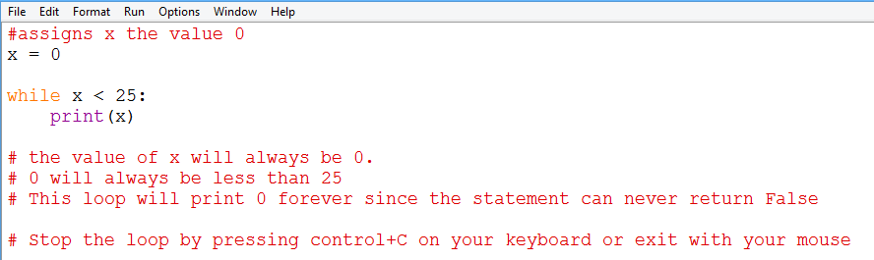
Infinite Loops
Infinite loops will continue looping forever
The conditional statement never becomes True
Notes:
#assigns x the value 0
x = 0
while x < 25:
print(x)
# the value of x will always be 0.
# 0 will always be less than 25
# This loop will print 0 forever since the statement can never return False
# Stop the loop by pressing control+C on your keyboard or exit with your mouse

Slide 22
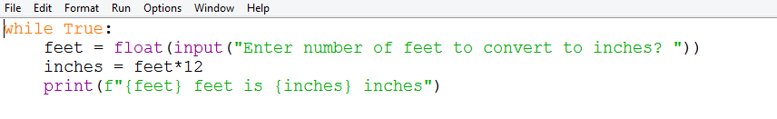
Infinite Loops
The computer evaluates x<25 to the Boolean value True.
Alternatively, you can create an infinite loop by just saying while True:

Slide 23
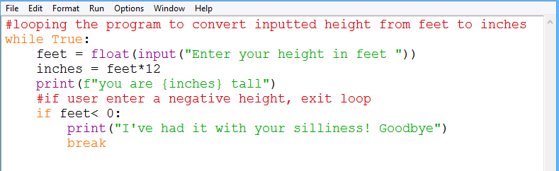
Infinite Loops
You can use keywords Break and Continue to redirect loops
Break will exit the loop.
Continue will re-run the loop from the beginning
These can only be used in loops.
Notes:
#looping the program to convert inputted height from feet to inches
while True:
feet = float(input("Enter your height in feet "))
inches = feet*12
print(f"you are {inches} tall")
#if user enter a negative height, exit loop
if feet< 0:
print("I've had it with your silliness! Goodbye")
break

Slide 24
Exercise #3
Create a program that asks “are we there yet”
Requirements:
Program should ask “Are we there yet” and allow user to input response.
If user enter “Yes” exit the program
Else, continue looping

Slide 25
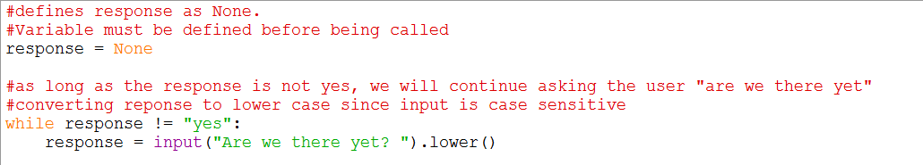
Solution #3
Notes:
name = input("What is your name? ")
print(f"Hello {name}")
#create list of students
items = ["Hairbrush", "Night Light", "Soap", "Straws"]
#greet each student in list
for i in items:
print(f"{i} cost one dollar")

